Slide 1

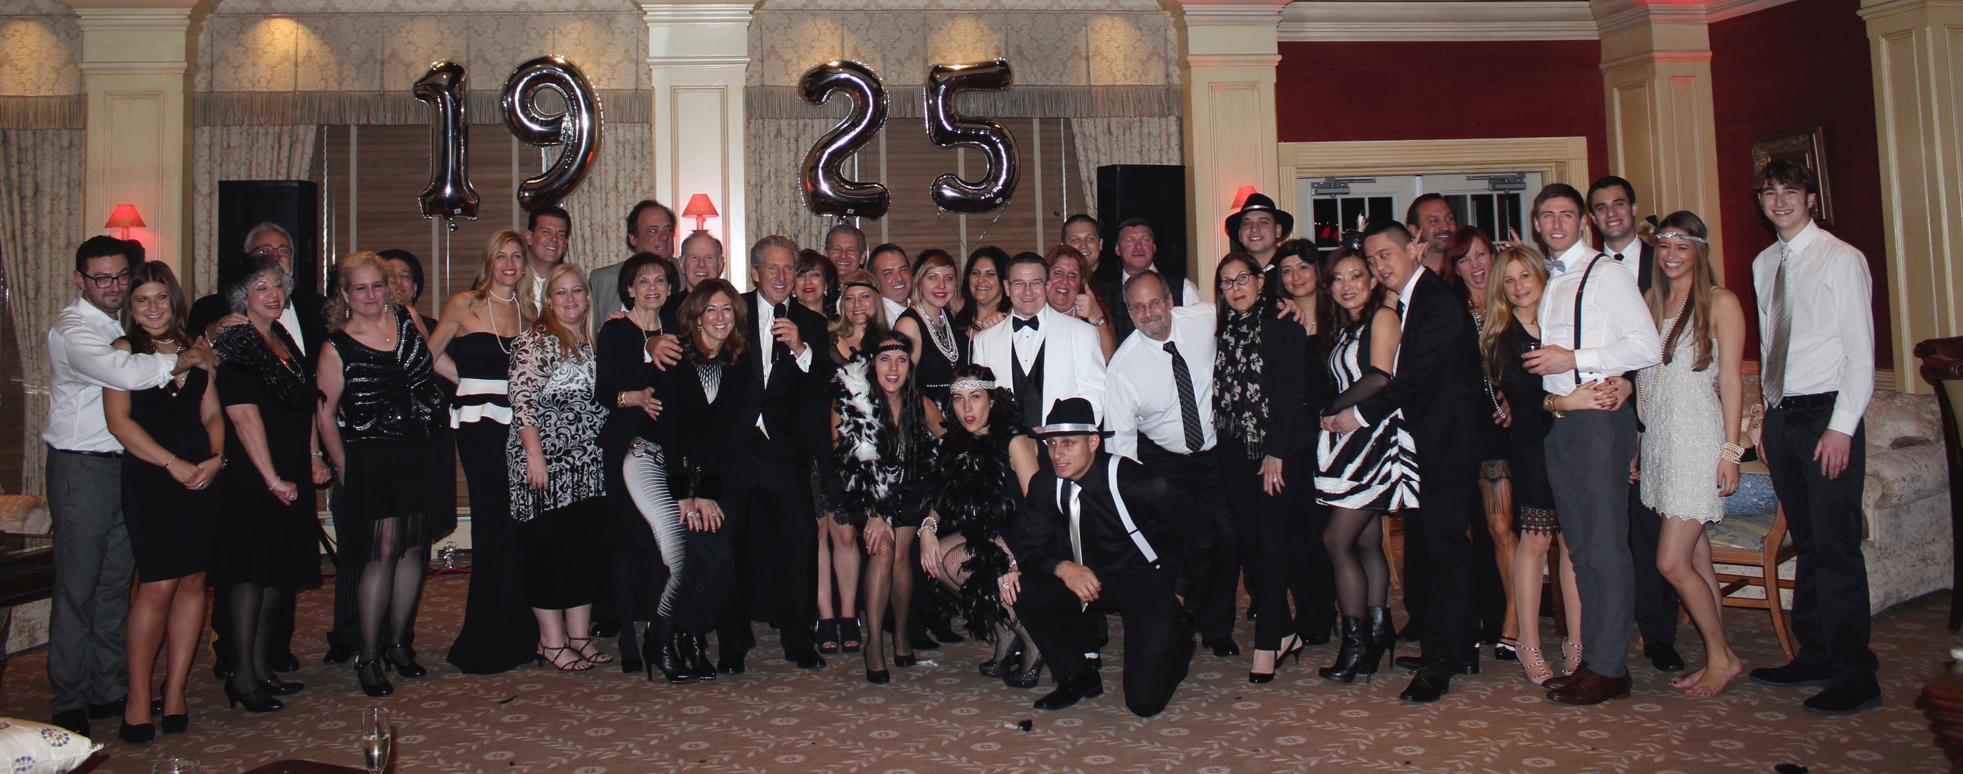
An organization succeeds,
not because it is big, or
because it is long established,
but because there are people in it
who live it, sleep it, dream it
and build future plans for it.

Slide 2
“We always behave exactly as promised, both because we have so promised and because we must in order to maintain our reputation, which we are enormously proud of”
“Opportunities arise when
the right people get together”
We are looking for people and agencies with fine reputations to merge into ours. You may retain ownership of your accounts or sell. You may continue working full-time, part-time or retire. We will provide and manage all back office services and staffing needs. We will make payments to your existing agency so that you retain the benefits of owning your own company. We will tailor your responsibilities or retirement around your desires.
If you sell, you will exchange a valuable asset, your business, for another valuable asset, cash.
If you join us, we should mutually do so with the realistic expectation that together we will become wealthier over time because we will have better opportunities together than apart.
We are experts in integration. Your office will be fully up and running on the 1st day of our deal. We have made 6 acquisitions, 2 since November 2014: The Pall Agency, Hersh & Braverman, The Gorham Agency, Corak & Guthart, Hamilton, Levy & Miller and The Jackson Agency.
Imagine this: Plenty of markets, no expenses, no employees, no management responsibilities, no production pressures from carriers.

Slide 3
Why Us?
MORE MARKETS
  We directly represent: Chubb, Hartford, Travelers, CNA, AIG, ACE, Encompass, Hanover, Amtrust, Philadelphia, Utica First, Progressive, Adirondack, Applied Underwriters, Fireman’s Fund and several Captive Insurance companies
  You may increase your book’s income from placing more accounts in standard markets and cross-selling
  You will have increased competitiveness and clout from more markets on renewals and new opportunities
  A BETTER QUALITY OF LIFE FOR YOU (and your staff)
  You will have the ability for more time off…with a clear head
  We will provide you with perpetuation and cash out
  You will not have the responsibility of running an office or staffing
  Your employees will live in a more enjoyable work environment with modern facilities, more interaction and comradery
  Both you and your staff will enjoy working more
BETTER SERVICE TO YOUR CLIENTS
  Your clients will get additional expertise, deeper staffing and an overall more professional experience
  There will be more backup when you or others are out of the office
  Faster turnaround from service requests such as Certificates of Insurance
  Quicker response time to questions both in and out of the office from State-of-the-Art automation
  Staffing in China for round the clock processing
  AUTOMATION
  We use Applied Systems and are paperless including virtually no outgoing mail. Not a daily or live file cabinet in the office!
  CSR 24 for natural disasters and blackouts
  Large screen TVs, video conferencing (in the office and during client visits), conference call-in rooms and signature conference facilities

Slide 4
“The partner you choose will determine
if the outcome exceeds or falls short
of your expectations”
You have spent the better part of your lifetime building your business. Selling your business or dramatically changing your operations is one of the most difficult decisions in an entrepreneur's life. People sell or merge their business usually only once, in an emotionally charged atmosphere with multiple pressures coming from different directions. The fact that your decision is so important, both financially and personally to you can make the process more, rather than less, prone to error. Mistakes made in the once-in-a-lifetime decision are not reversible. The formula/price is very important, but often it is not the most critical aspect of the transaction.
The most important question is “WHO DO YOU MAKE A DEAL WITH?”
The Integration of your business, honesty, accurate & timely payments, retention, cross-selling, increasing commission and the ability to deal with problems & opportunities are issues that will probably weigh more heavily than ‘the formula’ when determining how much money you earn during the term of the contract and your satisfaction with the deal.
HOW DO YOU MAKE THE CORRECT DECISION? We believe that interviewing others who were in your shoes will put you in the best position for this decision. We encourage you to ask any person we have previously made a deal with, any current or past employee or any insurance company any question about us. Ask about our performance versus our promises. We will be proud to be judged by their private independent answers.
It is not just about the formula!

Slide 5
“Give my son your insurance business or
I don’t buy meat from you any more”
Rebecca Butwin to Joe Brick, the butcher, 1925
In 1925 Nathan Butwin’s mother Rebecca threatened to take her business elsewhere if the neighborhood butcher did not buy insurance from her son. Joe Brick became his first client. It was also the first and only time extortion was necessary to get or keep a client. Butwin Insurance Group services over 10,000 companies and individuals in our state-of-the–art offices. We always draw on our historic strengths while at the same time abandoning comfortable routines when new opportunities require fresh thinking. Our reputation for honesty, intelligent thinking and being proactive precedes us in a competitive marketplace.
We have been cited in many national and local publications for our accomplishments and expertise. Cablevision’s “Business to Business and Beyond” tagged us as the “Compbusters” for our expertise in Workers Compensation. We have appeared in The New York Times, LA Times, Chicago Sun Times, Bergen Record, Long Island Business News, Accounting Today, CFO Magazine, 201 Great Ideas For Your Small Business, Bloomberg News, and Good Day NY, just to mention a few.
Richard S. Butwin, President & CEO of Butwin Insurance Group, is on the Board of Directors at Hanover Fire & Casualty Insurance Company.
Our website provides more information and represents our firm well. Please visit www.butwin.com
“2 AM is a lousy time to find out
you chose the wrong insurance broker”

Slide 6
Our 7 Divisions
BUTWINCOMMERCIAL Leaders in their field down to small offices. 1 location to 100.
BUTWINCAPTIVES Client ownership in a Captive Insurance Company
BUTWINVIP Personal Lines products & services geared to high net worth individuals
BUTWINPERSONAL Insuring homes, cars, jewelry and other possessions
BUTWINLIFE&BENEFITS Life Insurance, Estate Planning and Employee Benefits
BUTWINDIRECT Small business policies marketed directly over the internet
BUTWINEXPANDEDMARKET 2,000 salespeople of a national insurance company

Slide 7
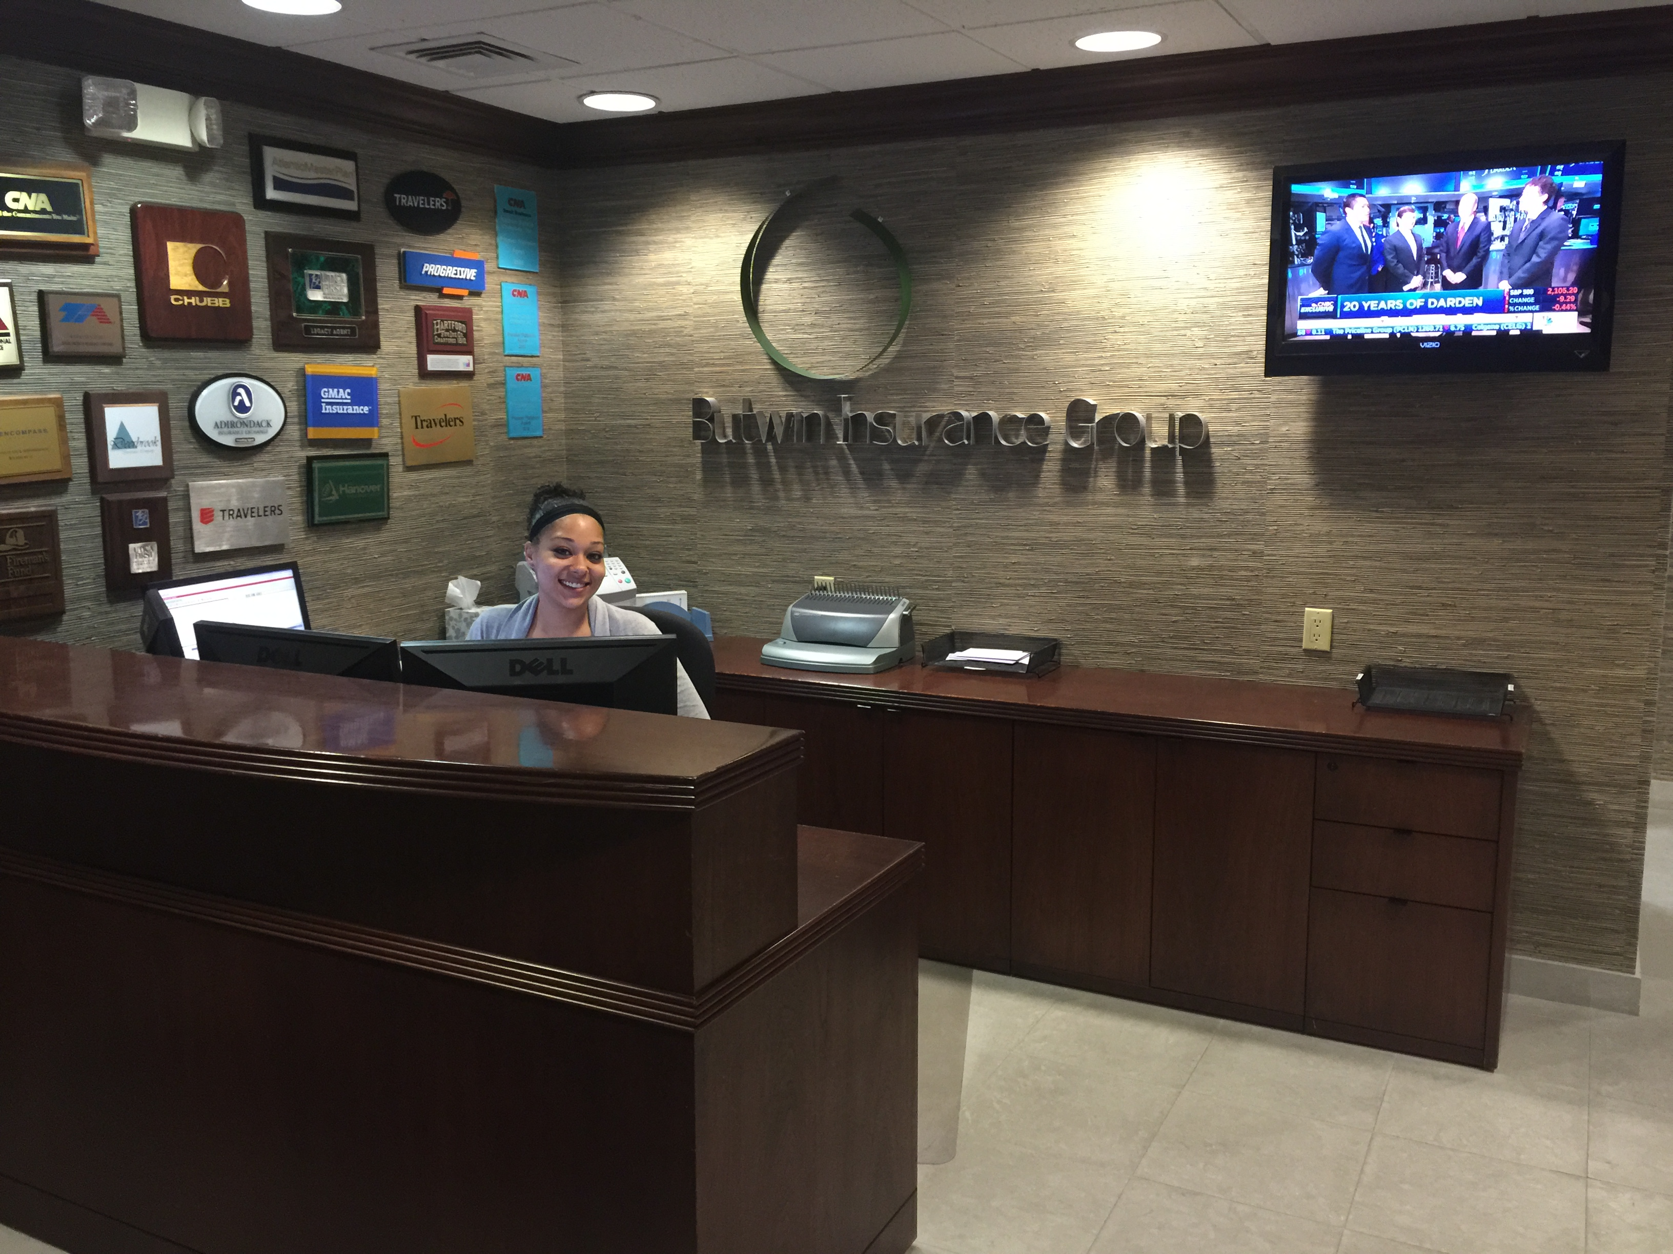
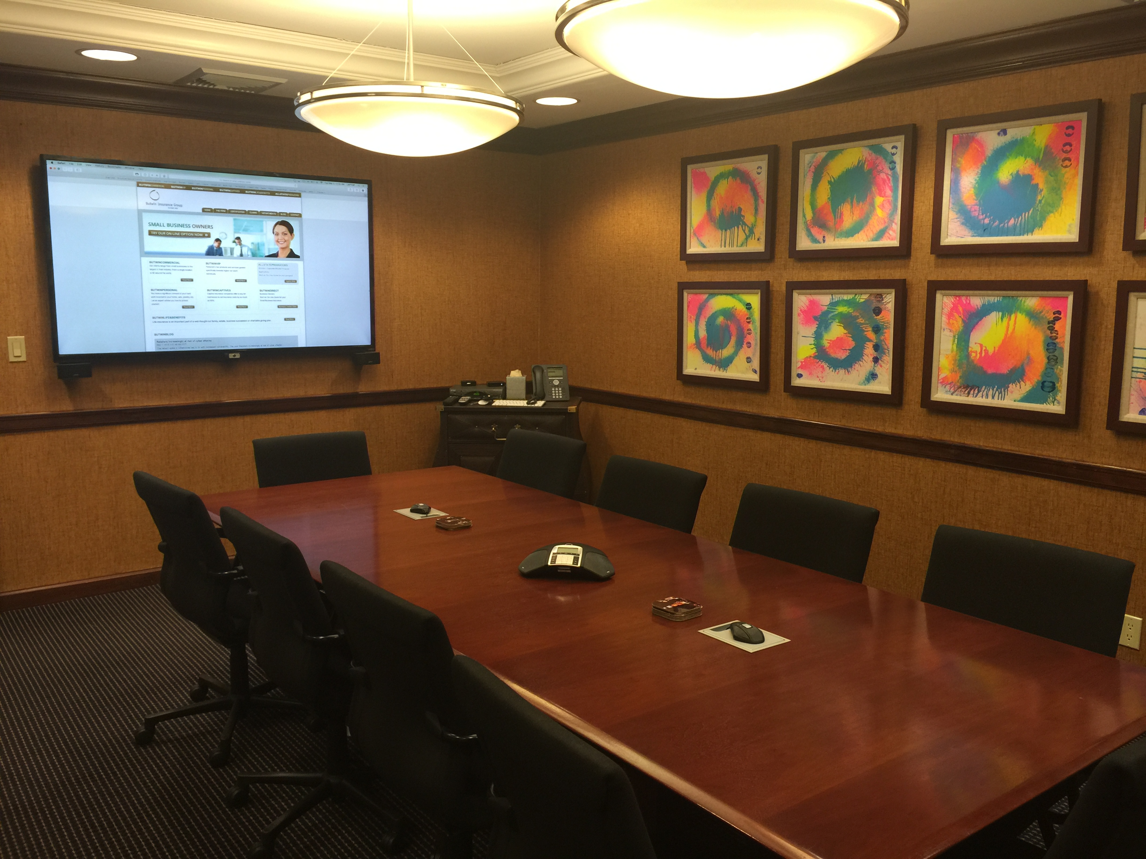

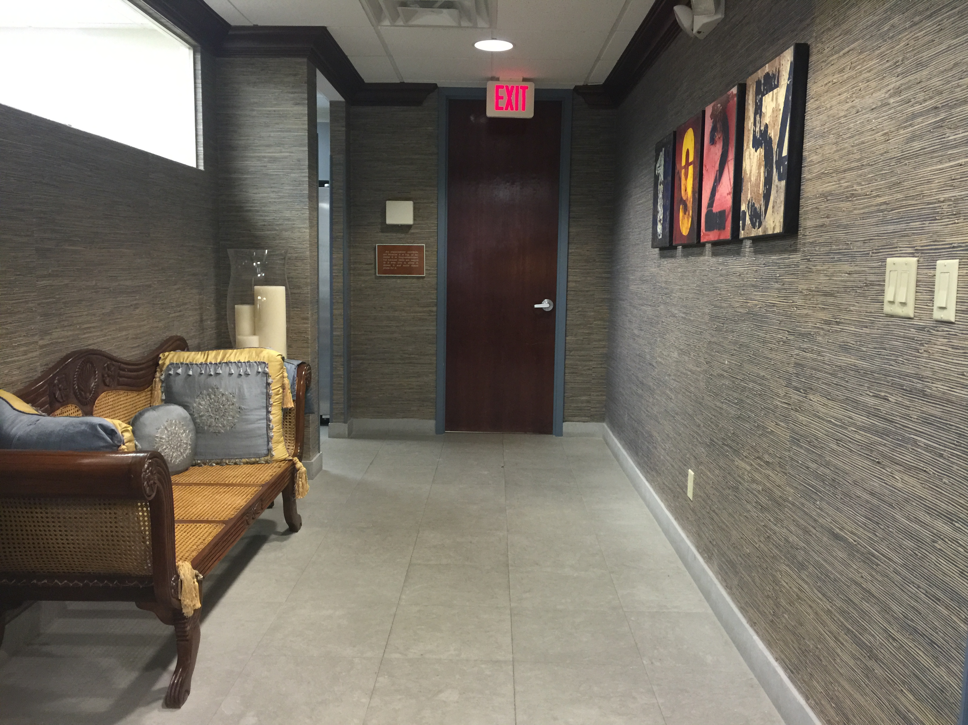

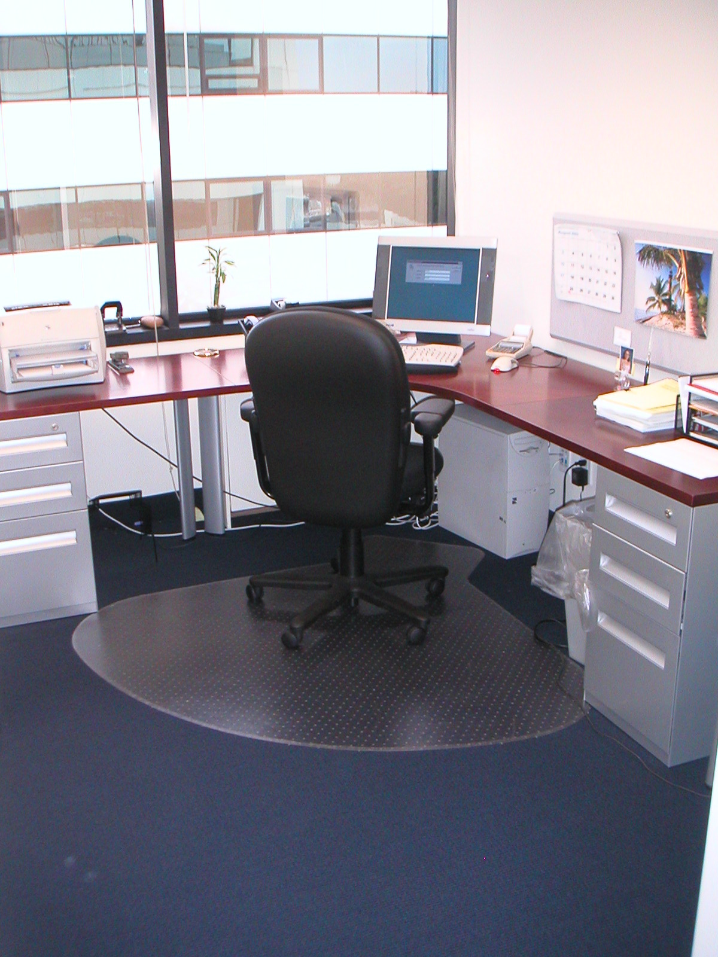
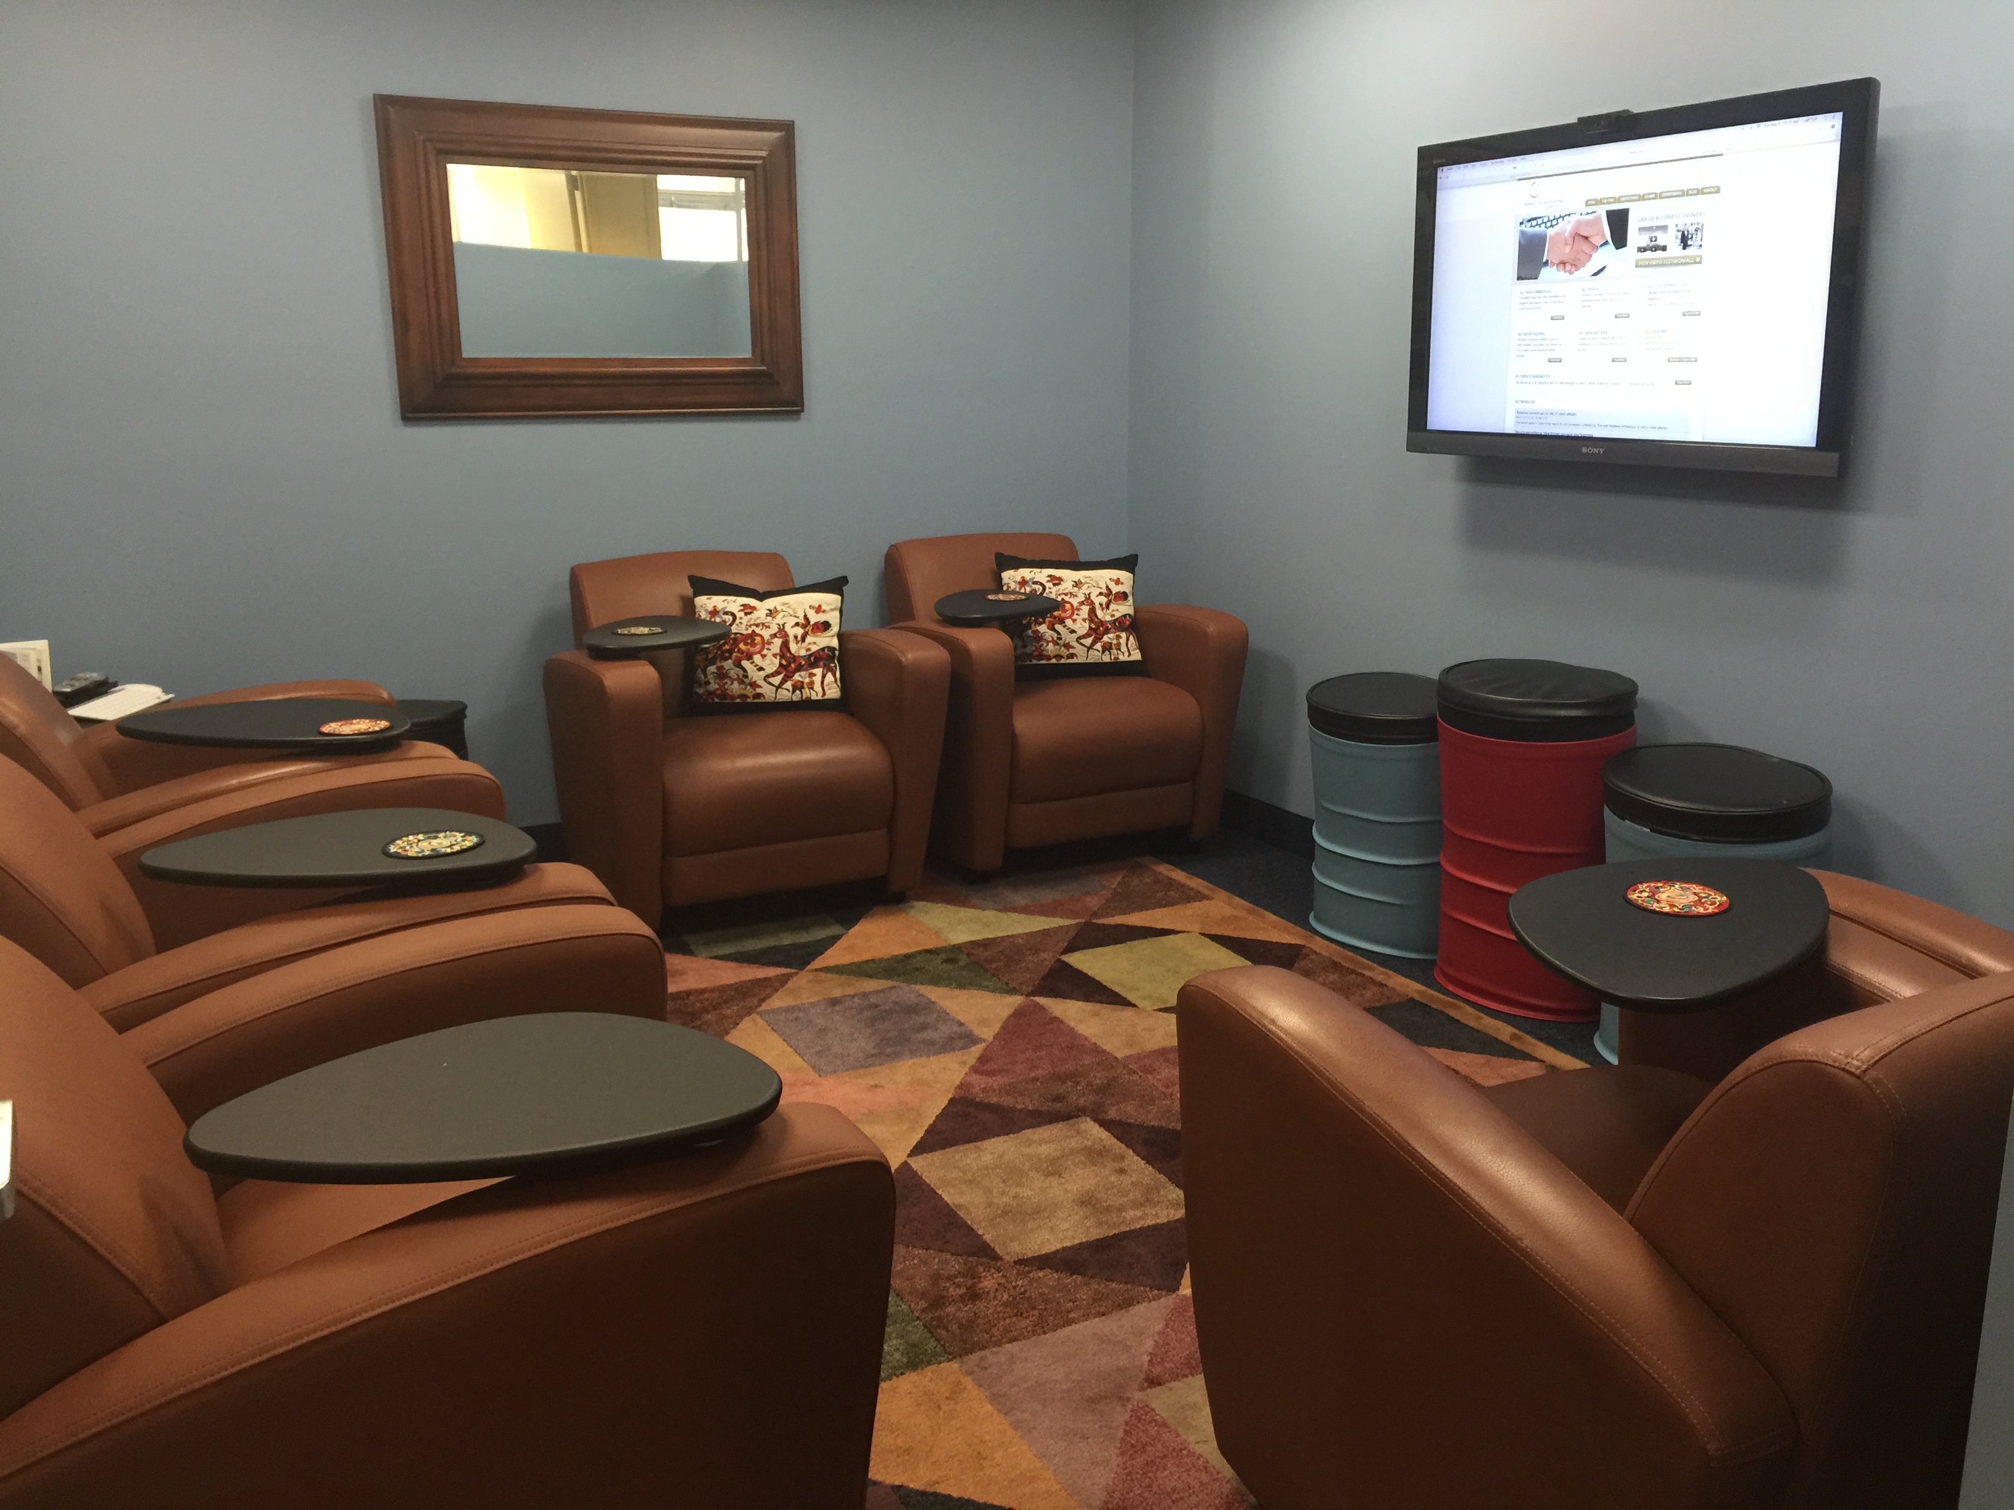
Our Facilities

Slide 8
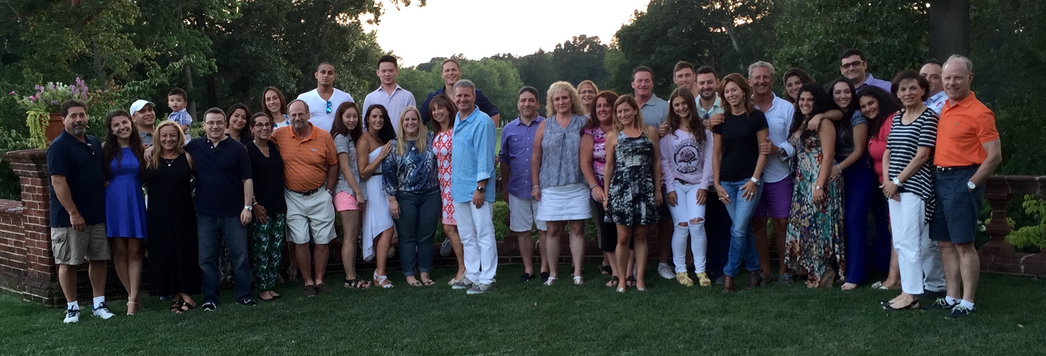
Our Mission Statement
We want to be a company where:
Every client feels we are
the finest insurance professionals
they have ever done business with
and
Every member of the firm feels
this is the best job they have ever had
RICHARD S. BUTWIN ROBERT E. BUTWIN
President & CEO President & COO
(516) 466-4200 x-111 (516) 466-4200 x-112
rbutwin@butwin.com rob.butwin@butwin.com
60 Cutter Mill Road, suite 414, Great Neck NY, 11021 ∙ 516-466-4200 ∙ www.butwin.com ∙ info@butwin.com

